Slide 1
Reaction Microscopy @ LCLS II
Drivers & Mottos & possible Program
FEL Capabilities & Wish List
Tool: Multidimensional Momentum Imaging
Imaging Bonds & molecular Structure
Access to dilute Targets
The Grail: Photo induced Chemical Reactions
Mechanisms of Radiation Damage & Dissociations
Towards the molecular Movie: Time resolved Studies
Hard X-ray Applications: Compton Scattering !?

Slide 2

Drivers: Connections to Real-World-Problems
Water splitting & artificial photosynthesis
Solve the energy problem with H₂
Generate drinking water
Efficient ways to desalinize seawater
Survive space travel
Root causes of ionizing radiation damage
Catalysis
Enable reactions with less energy
CO₂ sequestration & atmospheric chemistry
Store or crack greenhouse gases
Characterization and imaging of pharmaceuticals
characterize chiral systems and their degree of handedness
where can AMOS make a difference ?

Slide 3


Fundamentals of Chemistry:
Forming and
breaking molecular bonds
molecular puzzle
“How does nuclear dynamics induce electronic
transitions ?” and vice versa “how do
electronic transitions drive nuclear motion ?”
“What mechanisms are behind
electron emissions and where do
these particles go with respect to
the molecular structure ?”

Slide 4
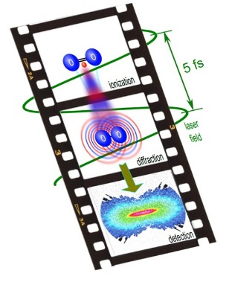
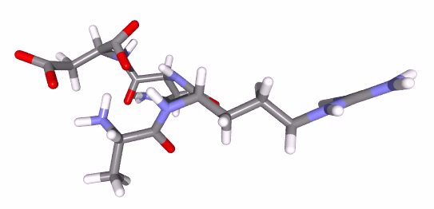
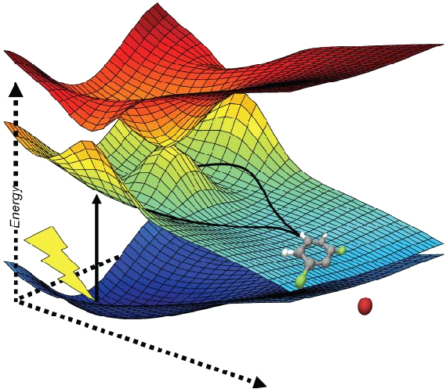
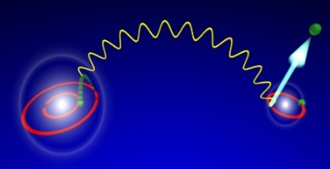
Potential AMOS Research Program:
Microscopy
a.) Structural imaging
of molecular bonds
static and time resolved
b.) Molecular dynamics in the formation
& breaking of complex molecules
probing PES, finding Conical Intersections,
non-Born Oppenheimer behavior
c.) Mechanisms of light-matter interaction
and dissociation processes
incl. non-linear, Compton scattering
diffractive
dream of the
molecular movie
Spectroscopy
Energy
dissipation
Kinematics & Dynamics
energy and particle transfer

Slide 5
SLAC II: new FEL capabilities
1 MHz repetition rate
2 undulators
< 20 fs pulses
250 to 5000 eV (@ 1 MHz)
1 to 20 keV (@ 120 Hz)
ΔE ~ 1.5 eV
Wish list:
circular polarized photons
< 10 μm² focus
THz streaking
Two color capabilities
HHG laser sources
10 days of beamtime in a row

Slide 6
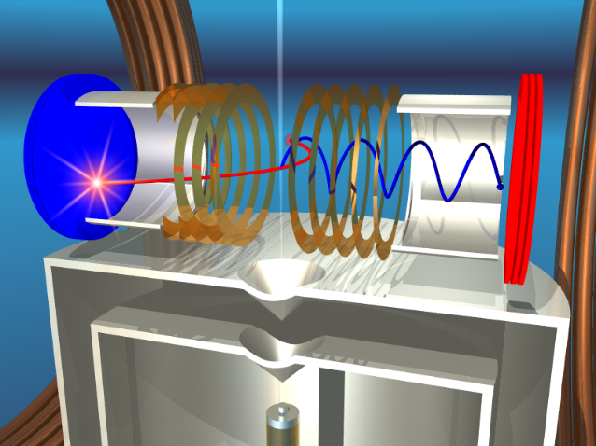
A powerful tool striving on high rep rate:
Multi-dimensional Momentum Imaging Spectroscopy
3d-momenta:
MOTION ► get emission direction AND kinetic energy
DYNAMICS ► changes reveal forces at work during
Time:
EVOLUTION ► with internal clocks, pump & probe
Target Manipulation:
CONTROL ► via (Laser) Excitation, Alignment, State mixing
Photo Chemistry at the mechanistic level

Slide 7
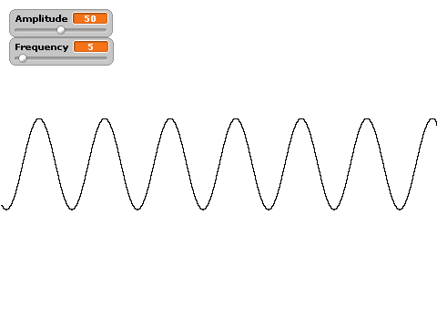
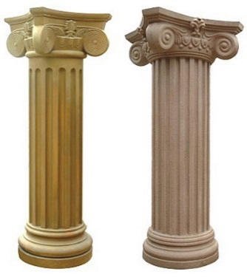
COLTRIMS - MOTTO
Respond to two of the “Five Grand Challenges”:
Understand and control the properties that emerge from complex correlations of atomic and electronic constituents
e₁
e₂
mol
Characterize and control matter (far) away- from equilibrium
operating at the interface of
atomic physics and molecular chemistry
Research Themes
Quantum Phenomena & Entanglement
Correlation & Many Body Dynamics
Ionization Mechanisms & Molecular Properties
Structural Imaging & Changes
non-Born-Oppenheimer & Energy/Charge Migration
Time Resolved Dynamics

Slide 8
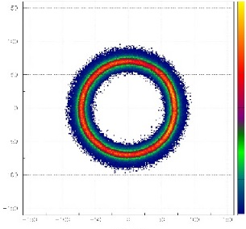
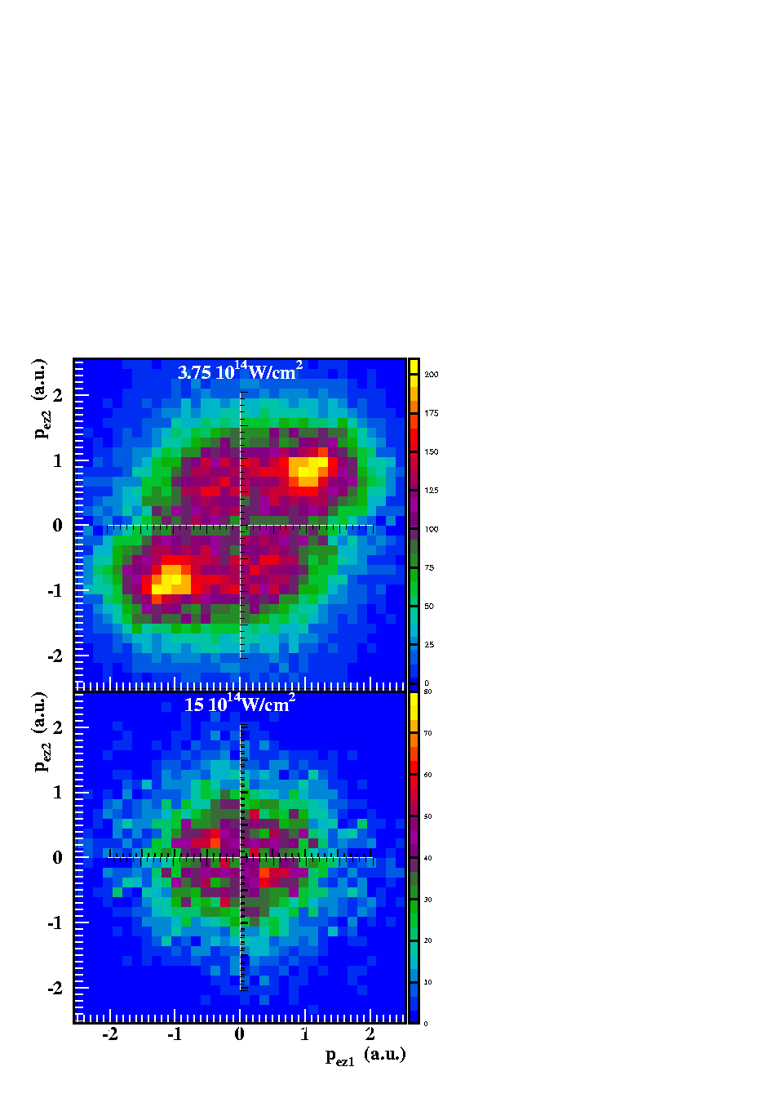
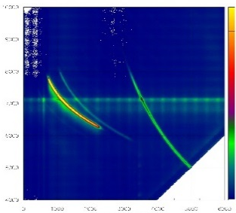
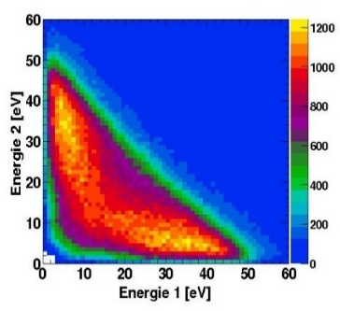
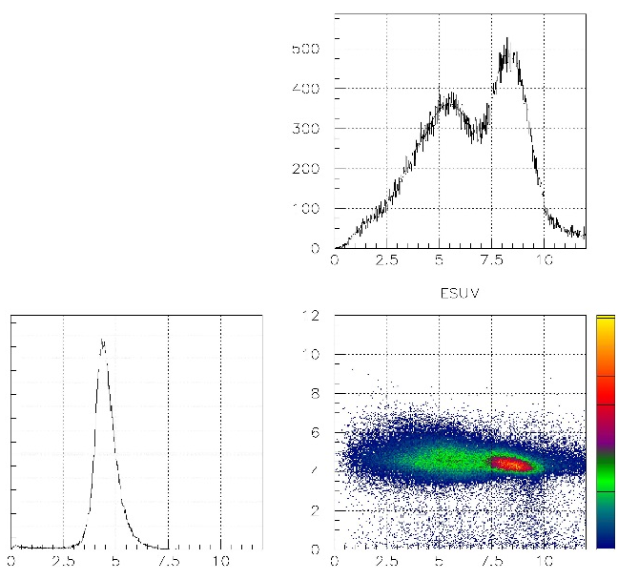
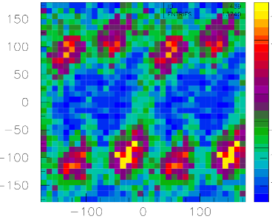
imaging these tools time dependent
the power of coincidences
DELIVERABLES:
Molecular Frame Photo/Augerelectron
Angular Distributions – MFPADs & MFAADs
PhotoIOn PhotoIOn COincidences – PIPICO
MOMentum Correlation Plots – MOMCs
Electron Energy Correlation diagram – EEC
Energy COrrelation Maps – ECOM
Particle Angular Distribution – PAD
ANGLE Correlation patterns – ANGLECs
p_{yr} in [a.u.]
p_{xr} in [a.u.]
H₂⁺ + C₂H₂⁺
Time of Flight Ion #2 [ns]
CH₂⁺ + CH₂⁺
H⁺ + C₂H₃⁺
Time of Flight Ion #1 [ns]
E_{Electrons} [eV]
Multi-dimensional
Momentum
Imaging Spectroscopy
KER [eV]
KER vs. E_{Electrons} [eV]

Slide 9
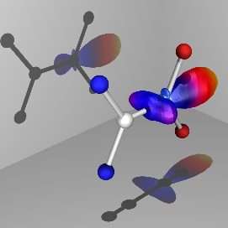
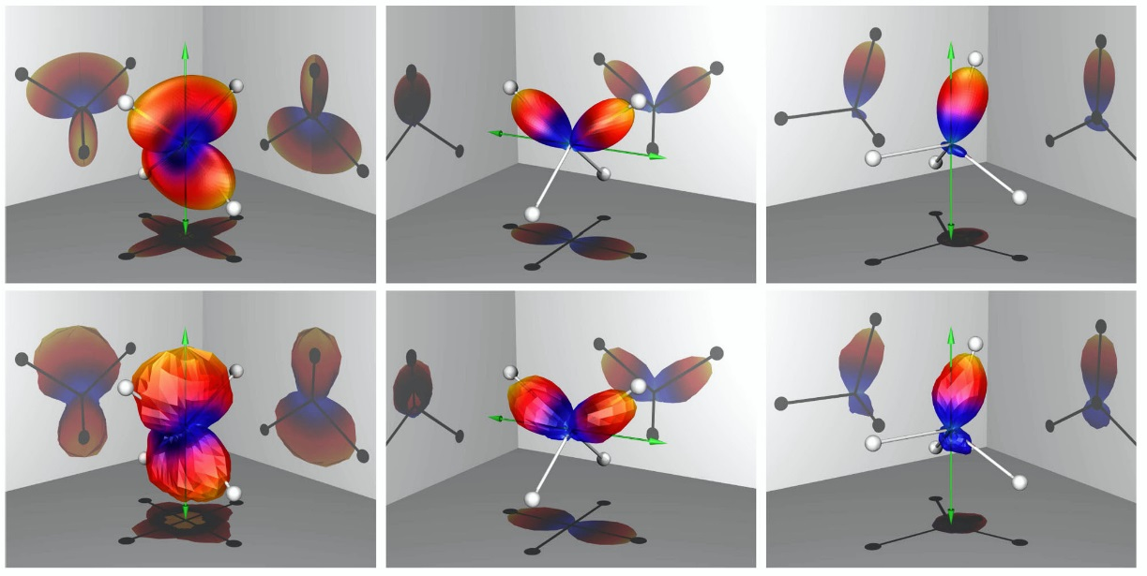
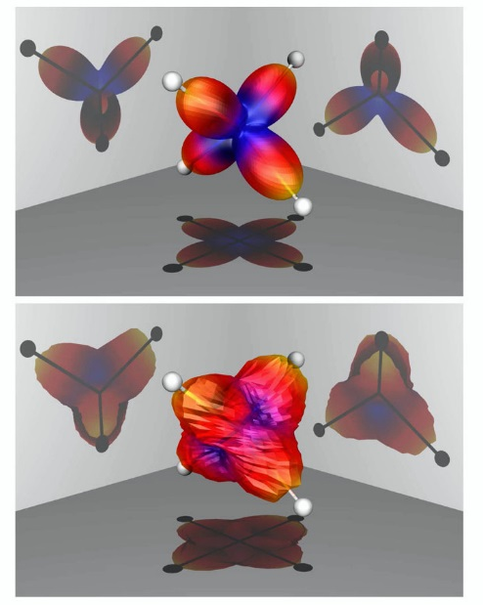
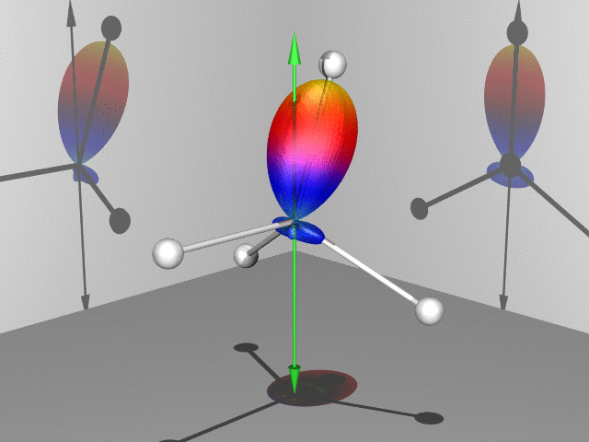
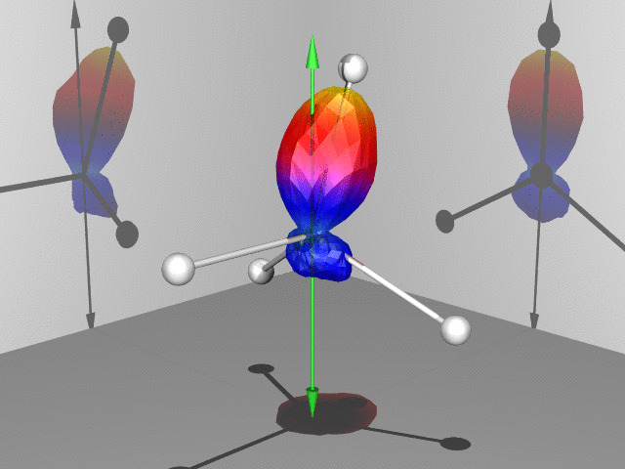
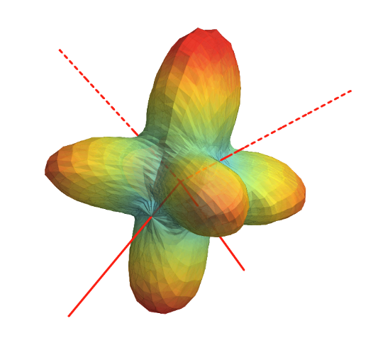
Structural imaging and anti-imaging of molecular bonds
examples from the ALS: CH₄ and CF₄ and C₂H₂F₂
ε || C₂
ε ⊥ C₂
ε ⊥ C₃
integrated
Microscopy
F
Illuminating molecular structure from within in 3d:
Attractive molecular wells vs partial charges
Now ad time dimension at FEL
F
J. Williams et al., PRL, 108, (2012), 233002
F
J. Williams et al., JPB, 45, (2012), 194003 + cover page on 2011/12 JPB-Highlights
F

Slide 10
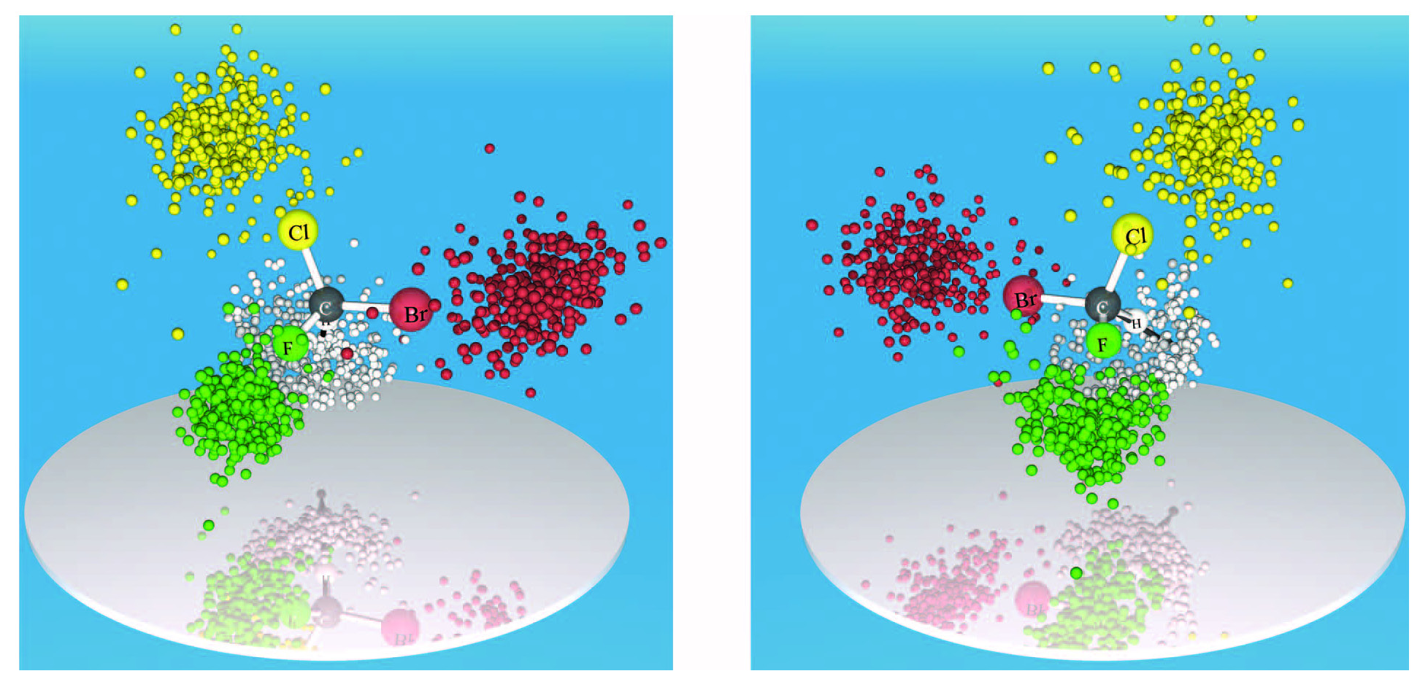
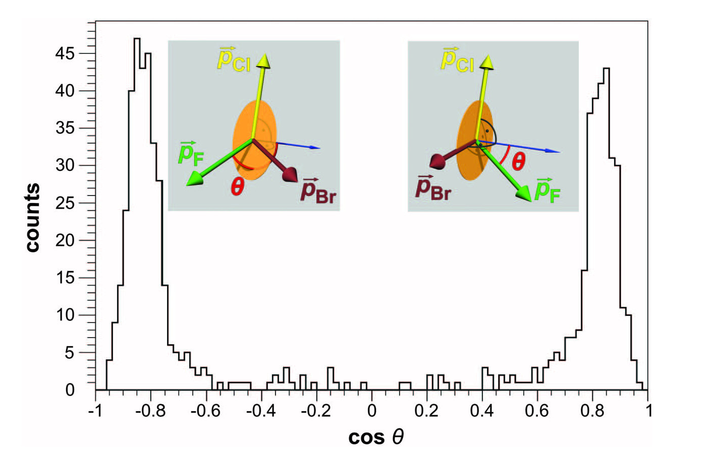
Imaging of molecular structure via Coulomb explosion
examples from Lasers: enantiomeres of chiral CHBrClF
grail in the pharmaceutical industry
M. Pitzer et al., Science, 341, 1096, (2013)
site specific ionization desired:
relying on multiple Auger decays or knock-out processes @ synchrotrons
= very inefficient
Microscopy
Mass/Charge sensitive
Coulomb Explosion Imaging
develop tool exploiting the FEL intensity to create high charge states, i.e. combine high intensities from Lasers with site specificity from synchrotrons
enantiomer concentration of a 50:50 mix

Slide 11
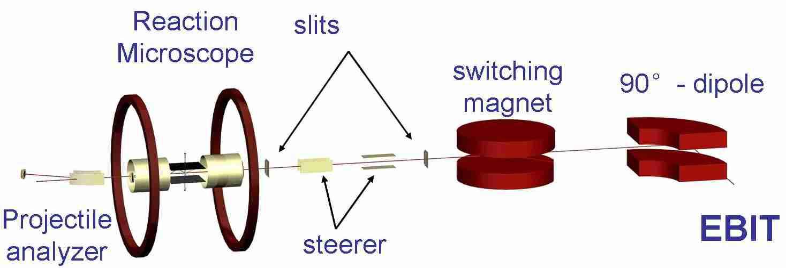
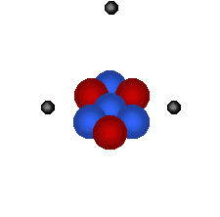
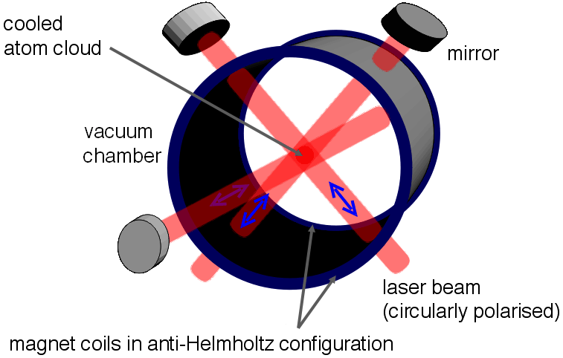
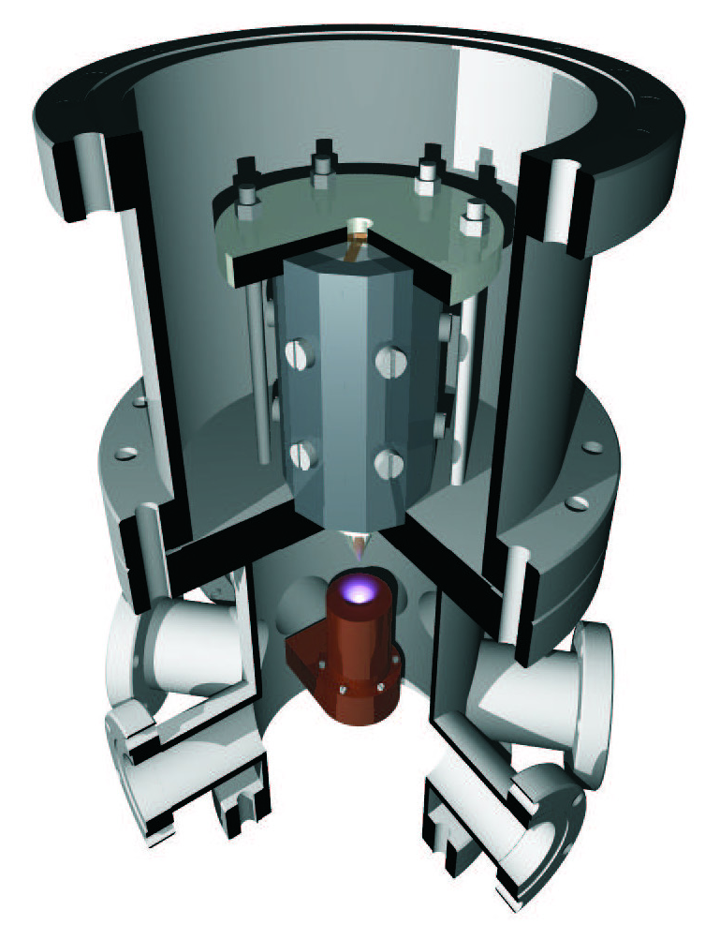
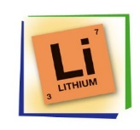
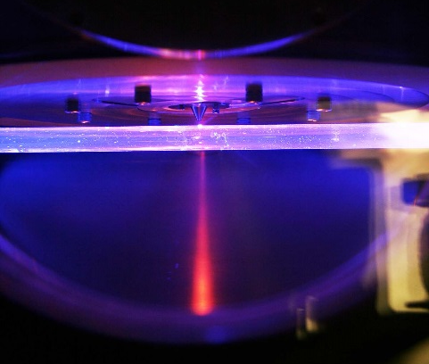
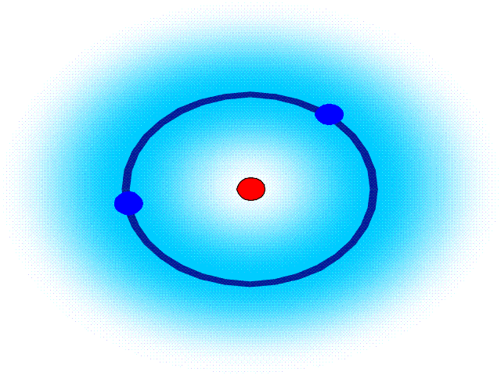
Dilute Targets: aligned, ultra-cold, ionized molecules & clusters…
(< 10⁶ to 10⁸ cm⁻³)
New Targets
high intensity & reprate: compensate small target densities
Fields in reach:
Photoelectron spectroscopy and photoelectron‐photoion coincidences in photoionization of atomic ions and spin polarized targets
Inner shell photodetachment and photofragmentation of atomic and molecular anions
Investigations of highly charged ions with EBIT or ECR source
Photoionization of single trapped atomic and molecular ions
Micro reactors….
antidepressant
spin polarized

Slide 12
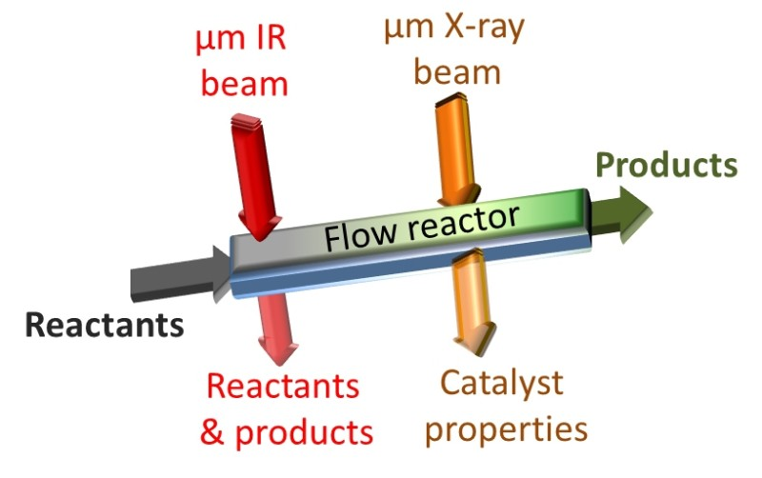
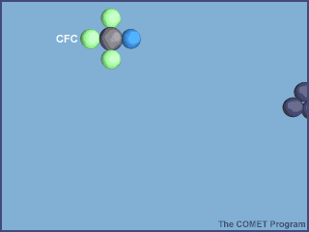

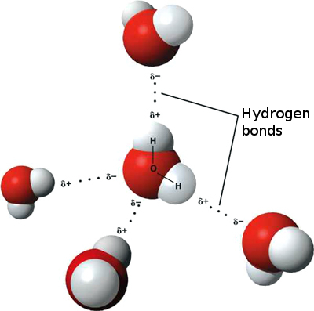
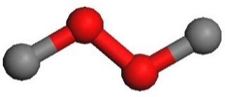
Photo induced chemical Reactions
Seeing bonds form & control secondary processes in real-time
Multidimensional imaging of:
efficient synthesis of pharmaceutical drugs and other flow reactor chemical products
e.g. Ozone depletion:
Cl + O₃ => ClO + O₂
ClO + O => Cl + O₂
Access to Reactions
chain-reaction in clusters or solvents
e⁻
e.g. ICD in water clusters followed by
dissociative electron attachment to neighbors

Slide 13
Photo induced chemical Reactions
Seeing bonds form & control secondary processes in real-time
General scheme:
Access to Reactions
AB + C → A + BC (e.g. IR pump)
→ A + B⁺ + C⁺ (X-ray probe)
exploit:
chemical shifts & (double) core hole shifts & resonances for identification
extend towards control:
strong (IR) field & laser alignment & excitation to drive the reaction
AB + C → AB* + C (control)
→ A + BC (e.g. IR pump)
→ A + B⁺ + C⁺ (X-ray probe)

Slide 14
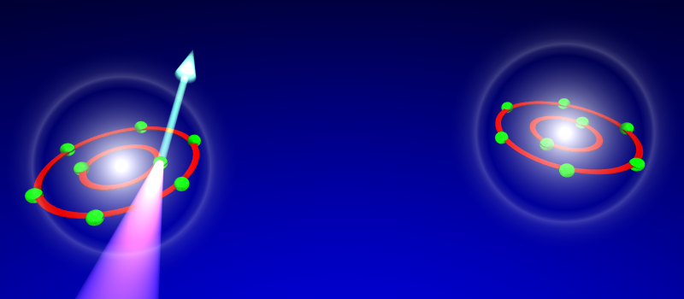
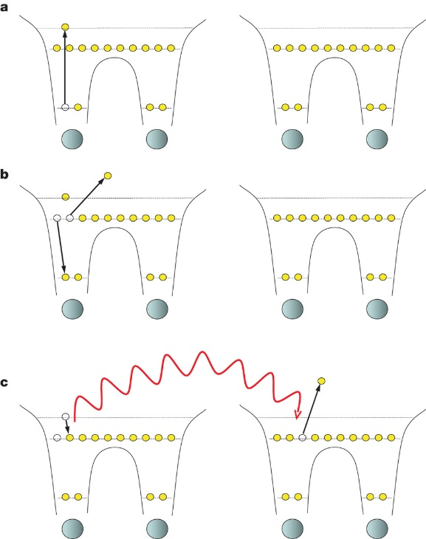
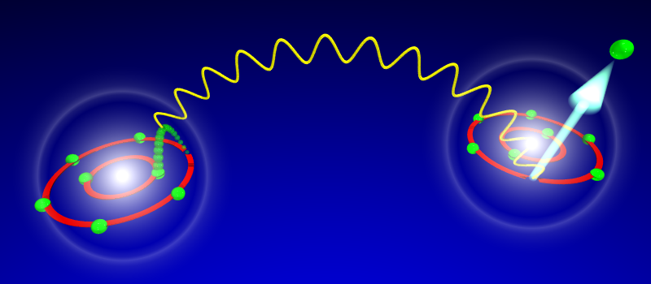
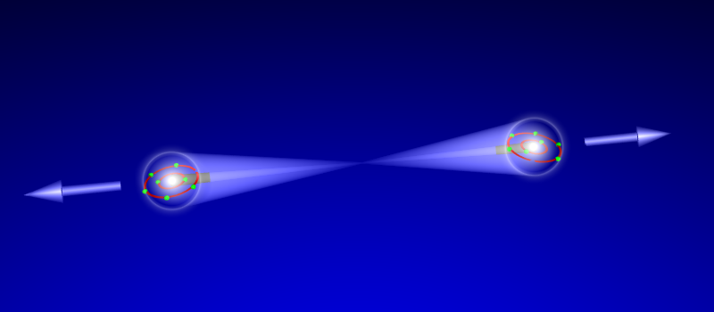
Mechanisms of radiation damage and dissociation processes
small dimers: (N₂)₂ and (CO)₂
Kinematics & Dynamics
Intermolecular Coulombic Decay: ultrafast energy transfer between neighbors
resonant excitation
1.) ionization
inner shell hole
Marker prepares ICD:
K-shell ionization with X-rays
localized spectator
Auger decay
effective Auger decay in excited dimer
2.) recombination
virtual photon exchange
suggested by
L. Cederbaum
group
virtual photon
exchange
3.) fragmentation
Coulomb explosion
But: need control about
site & energy transferred to exploit for treatment

Slide 15
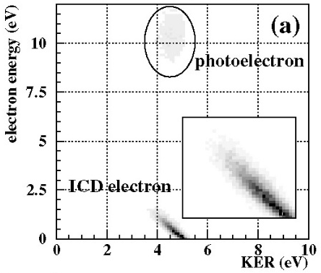
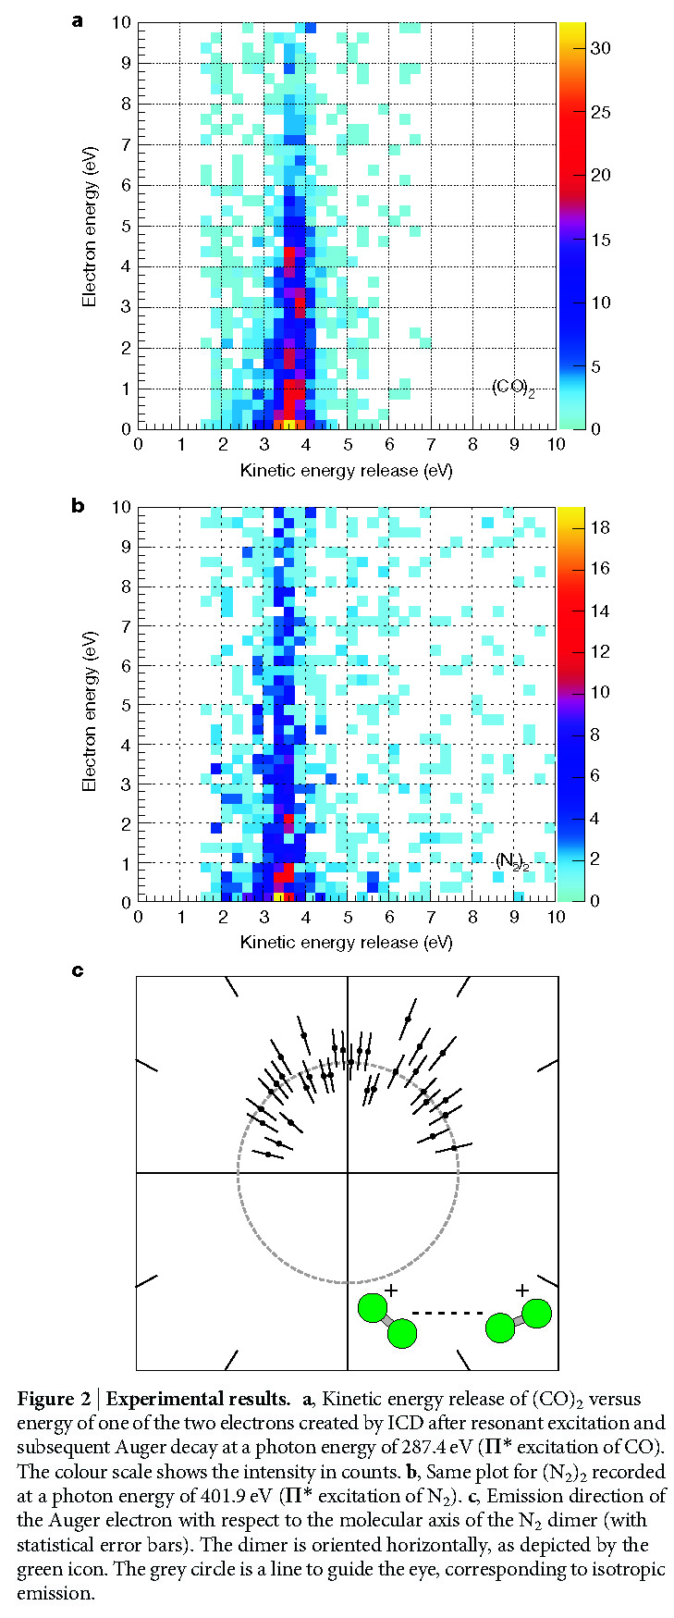
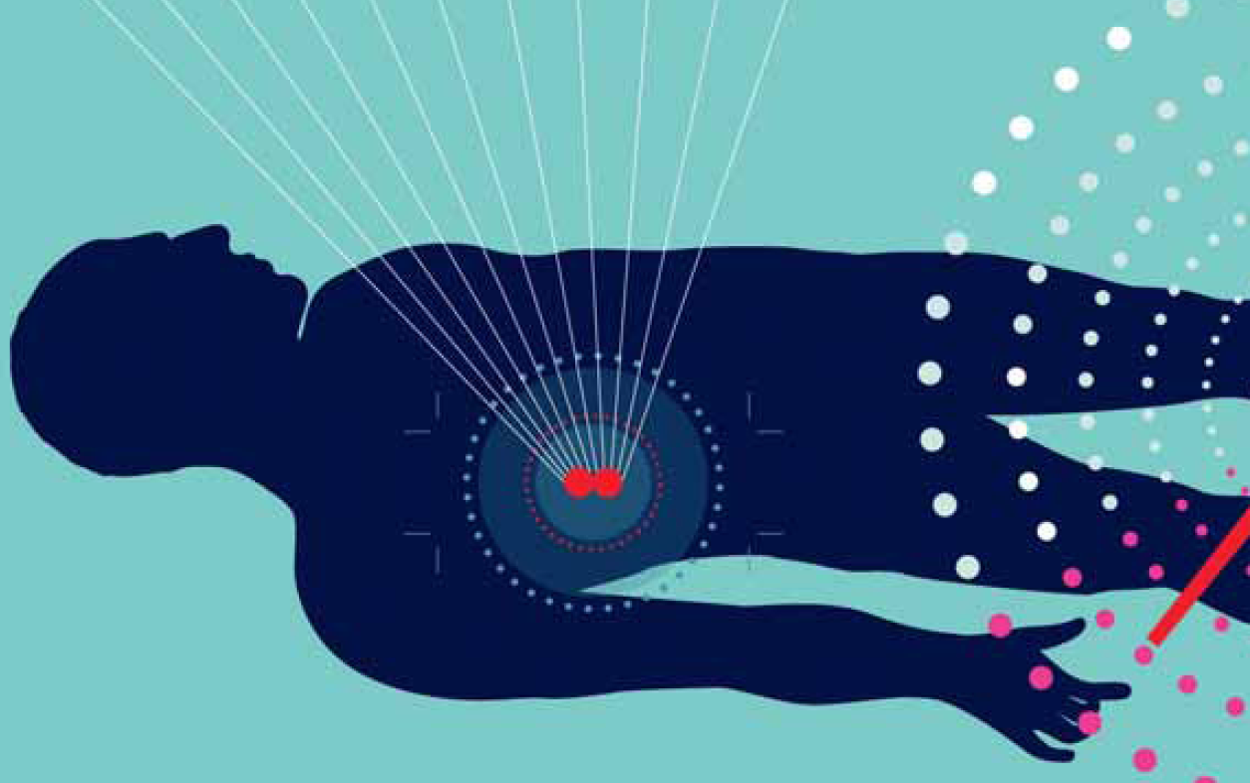
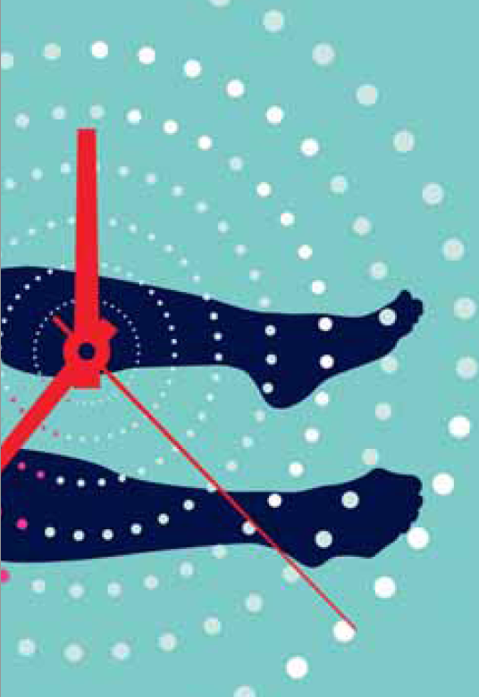
Mechanisms of radiation damage and dissociation processes
small dimers: (N₂)₂ and (CO)₂
Auger-electron
driven Cancer therapy
possible !?
hν(287eV) + (CO)₂
→ CO-CO*(^{1s-}1Π*)
→ CO-CO⁺* + e_{A}
→ CO⁺ + CO⁺ + e_{ICD}
discrete photo
and ICD electrons
Ne-Ne
CNRS – Internat. Mag., 33, (2014), 10
Resonant Auger ICD (RA-ICD)
really exists:
continuum of Auger
and ICD electrons
from excited states
CO-CO
monochromatic X-rays result in
10x more efficient (ICD)
site specific energy transfer
note: RA-ICD outpaces the dissociation of molecules (<20fs)
Natural next step:
time resolve
control
F. Trinter et al., Nature,
505, (2014), 664

Slide 16
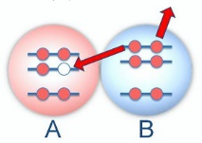
Control: Target manipulation via strong field perturbation
Expand towards control via IR pump & XUV probe
a.) Monitor laser driven fragmentation
Simple molecules (di- and triatomics, homonuclear):
Pump elec. or vib. states: Trigger dissociation & align/stretch molecule
Probe site specifically: use diffraction pattern as monitor
ETMD:
Can we tune in delocalized and localized electron emissions ?
Can the diffraction pattern be used as an internal clock ?
b.) Trace competing ionization mechanisms (ICD, ETMD, TS1) in strong fields
Small clusters (dimers and trimers):
Look for ICD in the presence of IR
Measure branching ratios & KER as function of E_{XUV}, I_{laser}, ΔΘ(ε_{VUV-Laser})
fundamentals of
controlling
catalytic reactions
Can environments be shrunk to enhance ETMD ?
Can electrons be steered to next neighbors to boost TS1 ?

Slide 17
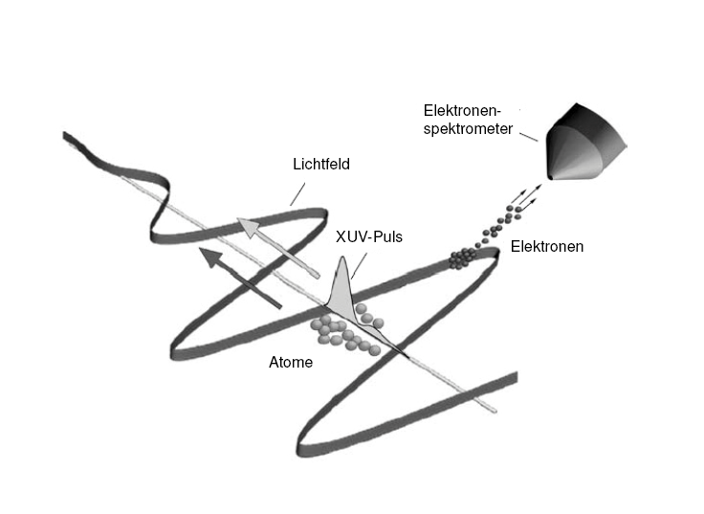
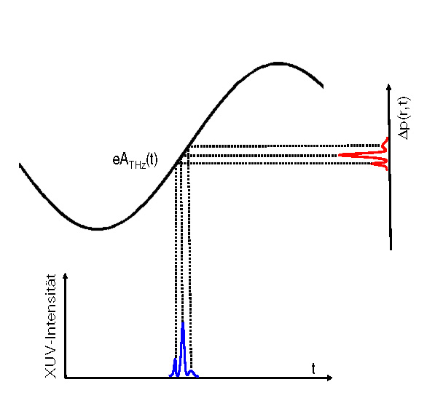
TIME RESOLVED MOMENTUM IMAGING: streaking – a must have
Electron Spectrometer
THz Streaking Field
XUV
Electrons
momentum
transfer
Atoms
XUV-intensity
excellent for time resolved investigation of decay mechanisms to the continuum (Auger decay, autoionization, ICD…)
predestined (but not limited) for XUV pump “drilling” inner-shell holes
a non-invasive probe for multi-step decays (e.g. double Auger decay)
complements pump&probe investigating dynamics of non-ionizing processes
no delay scanning necessary; streaking resolves time automatically
highly efficient probe step (pump might not even be saturated)

Slide 18
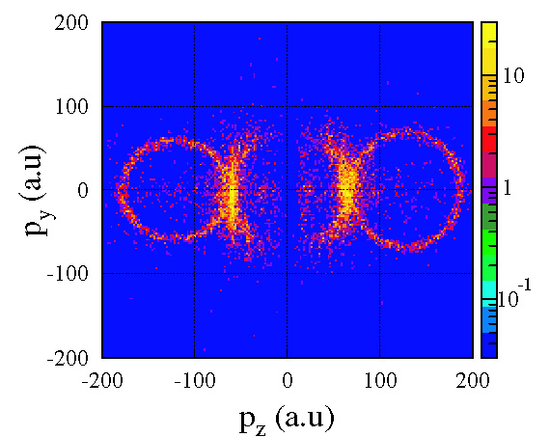
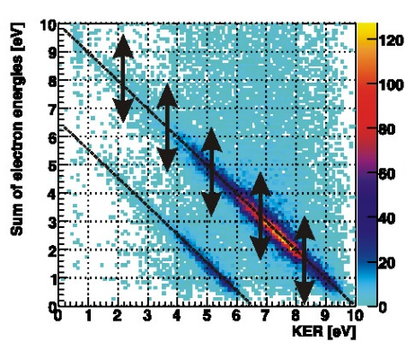
Challenge: Does streaking work for molecular processes ?
most molecular processes significantly exceed the times scale of 2.5fs periods from the 800nm IR field
Solution: Switch times scales
THz streaking extends the applicability of streaking techniques to the measurement of time-dependent
processes in molecules
alright – THZ it is:but…
Problem: Disentangle momentum transfer
- molecules emit electrons with broad energy distributions: What comes from physics – what from streaking?
- nuclear degrees of freedom participate in energy balance => kinetic energies of the ions are broad too
Solution: Track particles down in multidimensional phase space
- coincidence measurements of electrons and ions are needed
- the KER is not affected by the streaking field !
- KER + E_{e} = const. => energy of the electrons before streaking will be still accessible
“A phase locked Pump & Probe Scheme”:
pump: XUV excitation/ionization which triggers
dissociation/autoionization
probe: phase locked THz field transferring momenta
time evolution of dissociation/autoionization maps
into different momentum transfer of electrons which
get tagged individually by the THz field
ergo: measure momenta (coincidences are the key)
time can be extracted from the shift or broadening of
the (-1) diagonals (energy constants)
KER & E_{sum}= const.
real time
momentum plot
(illustration)

Slide 19
TIME RESOLVED MOMENTUM IMAGING:
streaking – a must have
time resolved dynamics
Possible Experiments: some examples
Time resolved ICD in dimers: < 100fs
Track molecular isomerization processes and subsequent dissociation in time (e.g. hydrocarbons: C₂H₄, C₂H₂,…): < 50fs
Chase competing/interfering atomic and molecular Auger decay paths in molecules after innervalence ionization and subsequent dissociation (CO, O₂,…): < 10fs

Slide 20
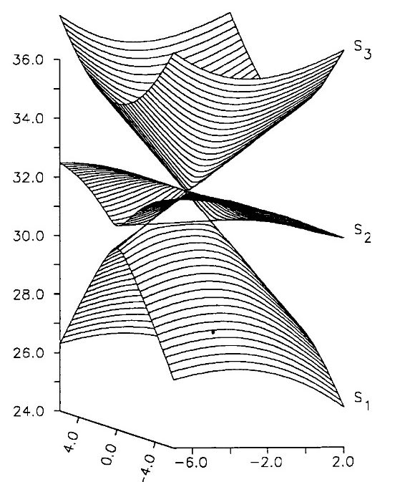
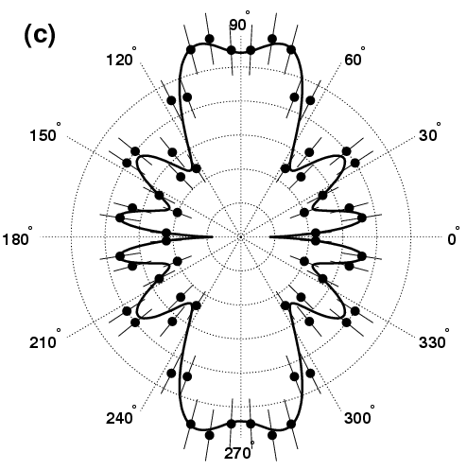
example: ALS
experiment
TOWARDS THE MOLECULAR MOVIE:
Fundamentals of Photochemistry in Realtime
Spectroscopy
Dynamics
Kinematics
E [eV]
E_{Auger}
can be done at synchrotron – now ad time dimension at FEL
torsion (C-C)
C=C stretch
KER [eV]
strong coupling of electronic
and nuclear motion = chemistry
Auger decay of C₂H₄ after K-shell ionization
finding conical intersections on the PES
tracking down non-Born Oppenheimer behavior on Auger decay time scales
seeing electron entanglement being preserved: there is structure in chaos

Slide 21

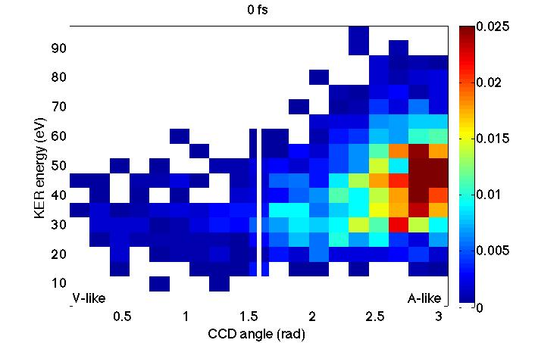
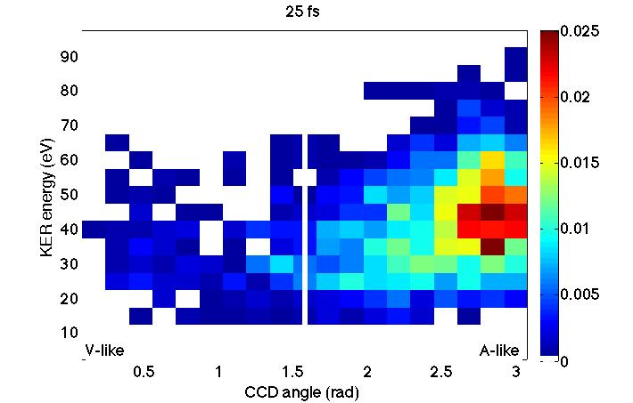
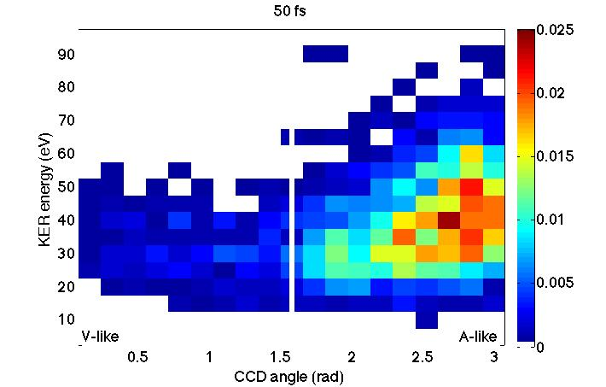
example: LCLS
experiment
TOWARDS THE MOLECULAR MOVIE:
Fundamentals of Photochemistry in Realtime
V. Petrovic et al., submitted, 2014
0 fs
25 fs
50 fs
KER [eV]
C-C-H angle [rad]
Vinylidene
K-shell ionization pump and K-shell ionization probe of C₂H₂
C⁺/C⁺/H⁺/H⁺ coincidences
tracking conformation changes in the C-C-H angle
we lack statistics & need high FEL reprate
Acetylene
Conformation Changes

Slide 22



complete three-dimensional electron momentum density (EMD)
Radiation Damage: Photon interaction with soft tissue
Attenuation mechanism of x-rays (> 5 keV)
hard X-rays
Compton Scattering probes:
complete three-dimensional electron momentum density (EMD)
part of wavefunction sensitive to electron-electron correlation
Nucleus at rest
investigate fixed in space Water and Water clusters
(time resolved pump-probe might be just in reach)
high intensity & reprate: compensate tiny cross sections (10⁻²⁴ cm²)
coincidences with ions: molecular frames & clean identification (pollution by absorption with 10⁻²⁰ cm²)
dλ = h/(m_{e}c) (1 – cosΘ)

